Slide 1
E- COMMERCE WEBSITE
DATABASE DESIGN WITH SAMPLE UPDATES USING MYSQL
A S SAI THEJASWINI

Slide 2
OUTLINE
The project is based on the sample database design of Myntra. Through the slide we would be able to understand the architecture, ER design and how enterprises use data base systems to manage the day-to-day operations, take up backups and generate reports. The relational data model, which saves the data in the table formats is used.

Slide 3
ER DIAGRAM – Entity - Attributes
Entity Attributes
Customer Customer name
Customer id
Customer address
Customer phone no.
Order no
Order Order no
Order amt
tracking no

Slide 4
Tracking details tracking no
Courier name
product id
Supplier Details Supplier contact
Supplier id
Supplier name
Product id

Slide 5
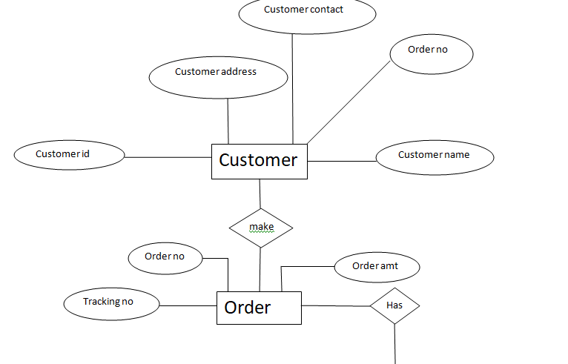
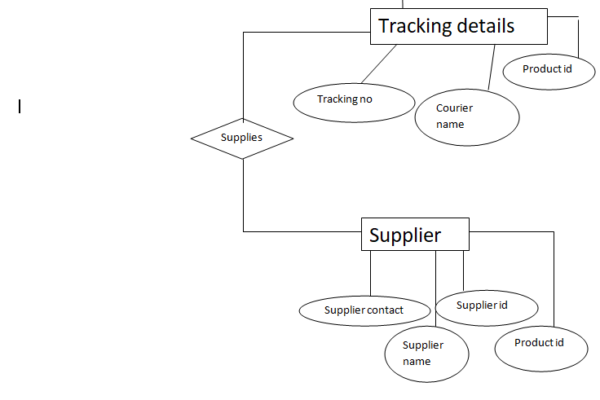

Slide 6
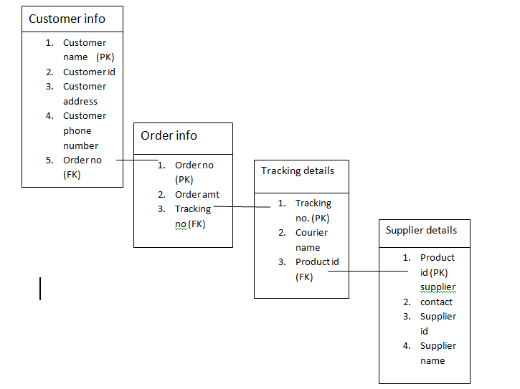
SCHEMA ARCHIETECTURE

Slide 7
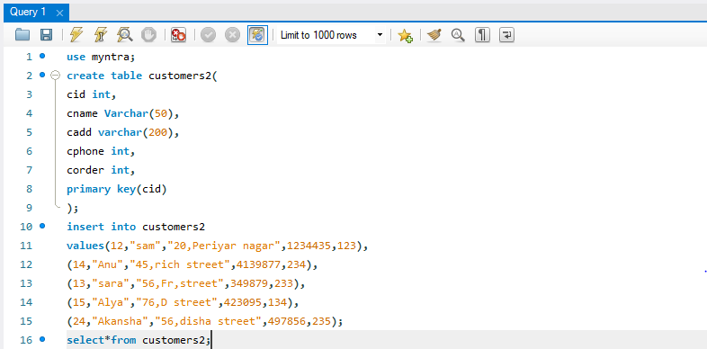
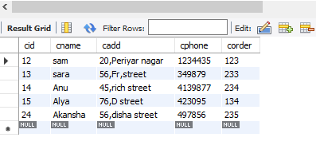
DATABASE AND TABLES 1. Customers table

Slide 8
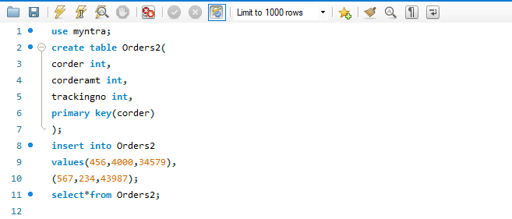
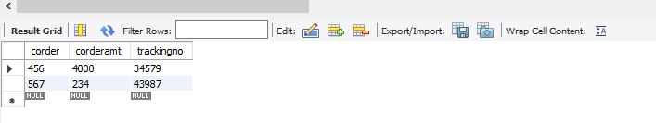
2. Order table

Slide 9
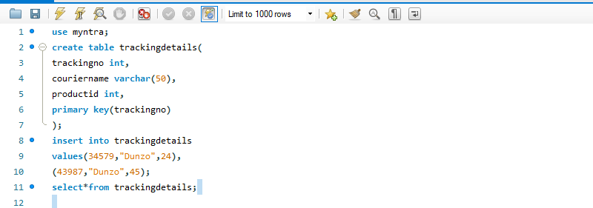
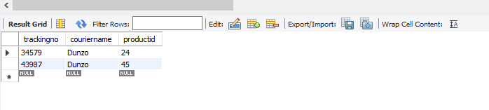
3.Tracking details table

Slide 10
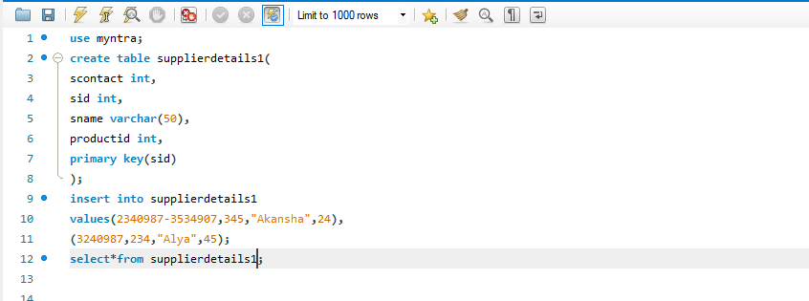
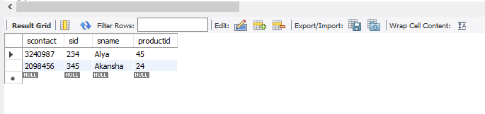
4.Supplier Details table

Slide 11
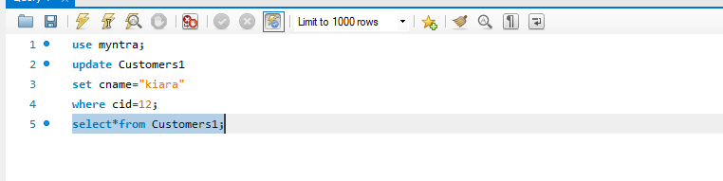
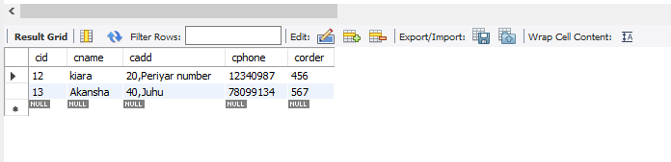
MYSQL QUERIES 1.Update a value in the table using update and where clause.

Slide 12
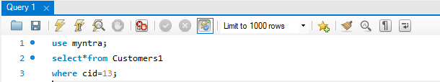
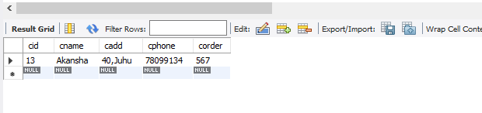
2. To select a particular row details from the table.

Slide 13
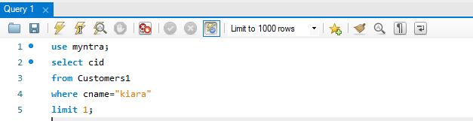
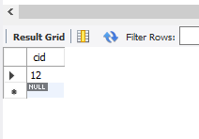
3. To select only one record from the table.

Slide 14





4. Count and Distinct from all the tables

Slide 15





Slide 16




5. Like Operators

Slide 17
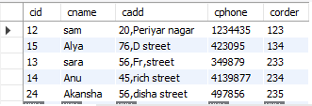
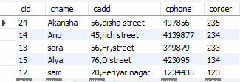


6. Order by, and , between – not between , in

Slide 18




Slide 19




7. Alter and modify table.

Slide 20



8. Max (),Min () and sum()

Slide 21


9. As, joins, unions.

Slide 22



Slide 23

INNER JOIN:

Slide 24

OUTER JOIN:

Slide 25


INNER JOIN

Slide 26


RIGHT JOIN

Slide 27
THANK YOU!

